Slide 1
CDR Lathe Reference Figures

Slide 2
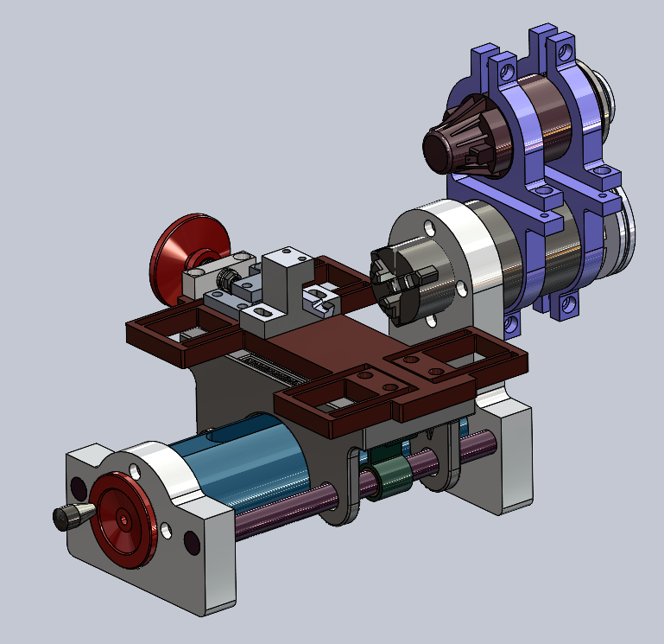

Slide 3
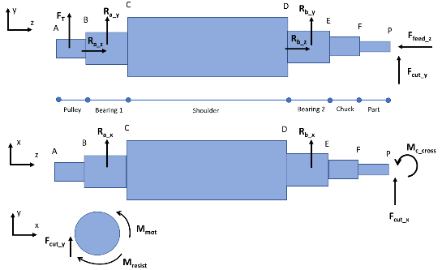

Slide 4
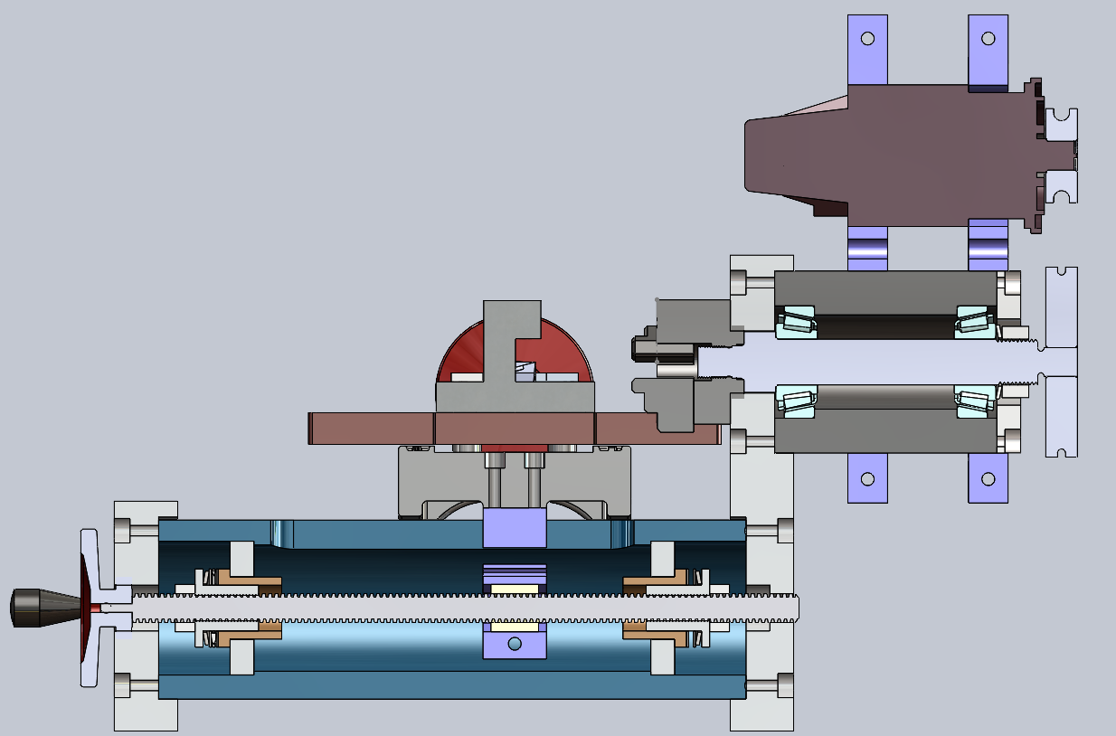


T_ef:
Y = 0
Z = L_ef = 18mm
T_fp:
Y = 0
Z = L_part = 5cm
P_tool:
Y = 0
X = - D_part / 2 = 2cm
$$T_{fp}$$
$$T_{ef}$$
Spindle+bearing δ and θ totals
Y
Z

Slide 5
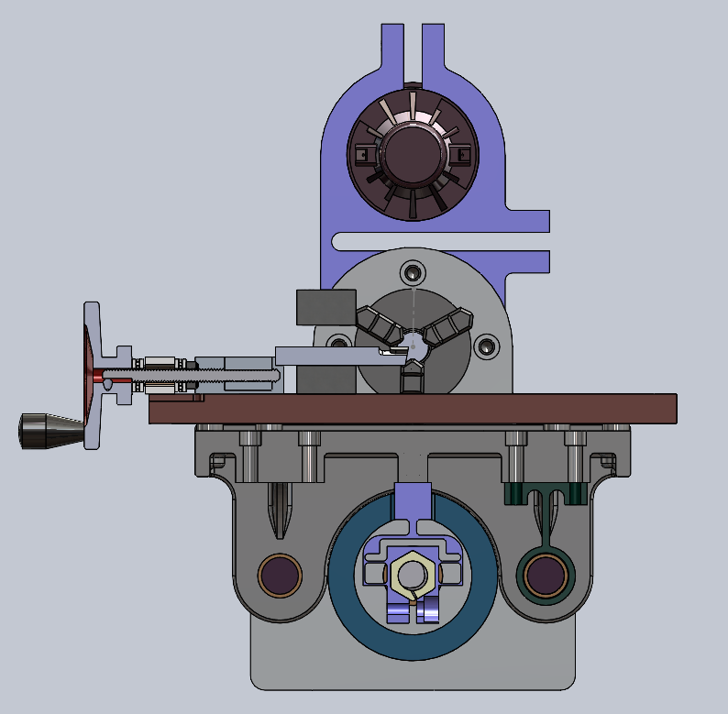



T_tool:
Y = h_tool = 0.375in
X = L_ tool_free = 1.5in
T_toolpost:
Y = h_tool_flexure = 0.48in
X = L_ tool_holes = 0.5in
T_flexure:
Y = h_flexure = 0.5in
X = L_flexure_center = -2.939cm
$$T_{tool}$$
$$T_{toolpost}$$
$$T_{flexure}$$
Y
X

Slide 6
Current Spindle HTMs
Current X-slide HTMs
Proposed Path 2
Proposed Path 1
Y
Z

